Slide 1

Windows 7 Security
Jorge Orchilles
Terremark Worldwide

Slide 2

About Me
IT Consultant over 7 years ago
Security Analyst at Terremark
Master’s of Science in Management Information Systems @ FIU
Author of Microsoft Windows 7 Administrator’s Reference, Syngress Publishing
Few certs: CCDA, CSSDS, MCTS, MCP, Security+

Slide 3
Audience Survey
XP Users?
Vista Users?
Windows 7 Users?
Mac OS X?
Linux/Unix?

Slide 4
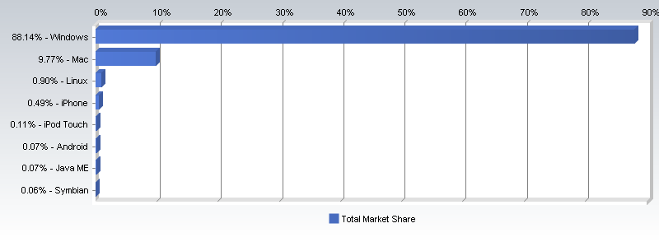
Reality
March 2009 Survey - ComputerWorld
88% Windows
10% Mac
1% Linux

Slide 5
Reality
Up to 94% of corporations skipped Windows Vista
New PC users had a choice to “downgrade” to XP
New OEM PCs will include Windows 7 and no choice for Windows Vista or XP for that matter.
All enterprise systems will be required to upgrade to either Vista or Windows 7 soon! Microsoft is threatening cut off dates already.
Windows XP is 8 years old!

Slide 6

Windows Vista
FAIL?
Why?
Bad Press
Horrible release

Slide 7



Windows Vista - Security Fail? Not so much
Fewer High Security Vulnerabilities in Year 1
60% Fewer Malware Infections Than Windows XP SP2
Mac OS X
10.4
Ubuntu
6.06 LTS
Red Hat
EL4WS
Reduced

Slide 8
Windows Vista - Security Features
Security Development Lifecycle
Windows Service Hardening
Windows Defender
Internet Explorer 7 w/Phishing Filter
NG TCP/IP –IPv6, IPSec., WFP
Vista Firewall – inbound and outbound
Network Access Protection
User Account Control – consent and credential prompting
Code Integrity – all OS DLLS and exec digitally signed
BitLocker, Encrypted File Systems, & Trusted Platform Module

Slide 9

Agenda
Introduction to Windows 7
Incremental update to Windows Vista
Uses the same technologies already in place with Vista
Simpler user interface and enhancements to performance
Extensive UAT via public Beta and RC
Introduction to Windows 7
Internet Explorer 8
BitLocker and BitLocker to Go
AppLocker

Slide 10
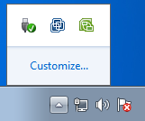
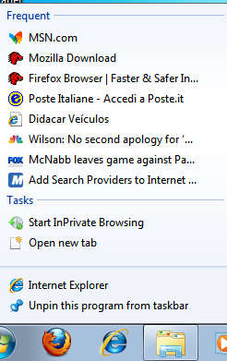
New Desktop Features
User Interface
Taskbar – Notifications
Aero Peak and Aero Snap
Jump Lists
Desktop Search
Driver and Device Support
HomeGroup
Windows Media Player/Center

Slide 11
Security Features
Action Center
Better UAC
Better BitLocker
BitLocker ToGo
Biometric security
Internet Explorer 8
AppLocker
DirectAccess
PowerShell v2

Slide 12
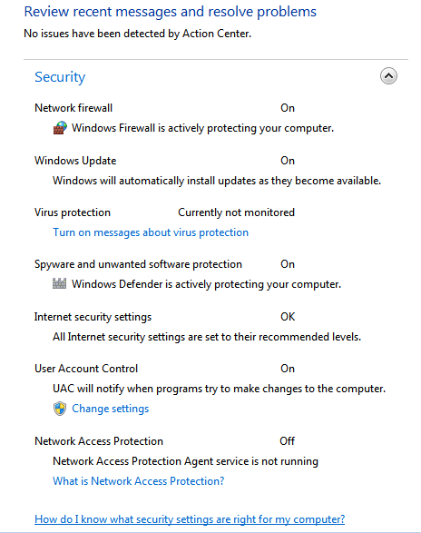
Action Center - Security
Replaces Security Center
Firewall
Windows Update
Virus Protection
Spyware / other malware
Internet Security Settings
User Account Control
Network Access Protection

Slide 13
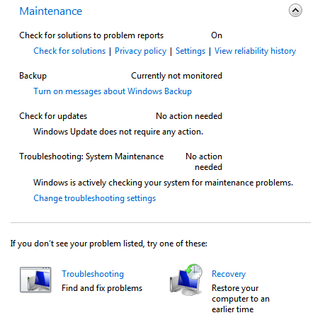
Agenda
Action Center - Maintenance
Check for solutions to problems
Backup
Check for updates
Troubleshooting
Recovery
Introduction to Windows 7
Internet Explorer 8
BitLocker and BitLocker to Go
AppLocker

Slide 14
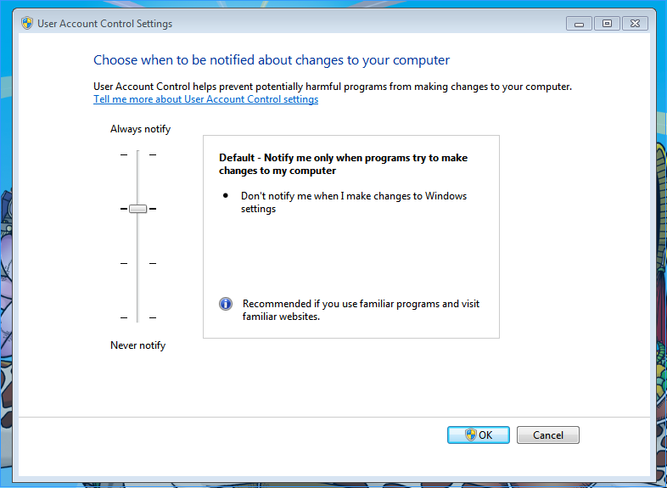
Agenda
User Account Control
Less nagging
GUI for customizing
Helpful?
Introduction to Windows 7
Internet Explorer 8
BitLocker and BitLocker to Go
AppLocker

Slide 15
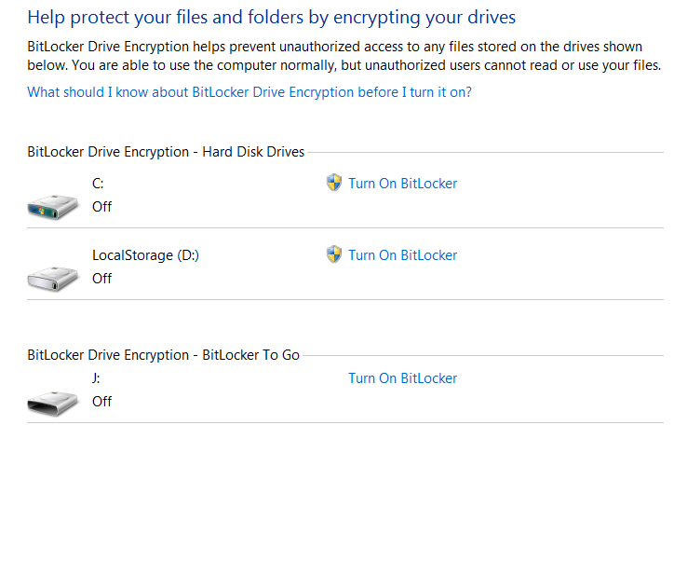
BitLocker
Introduced in Windows Vista
Encrypts the system volume, including the page file and hibernation files
No need for partitioning!
Whole drive/volume encryption
Trusted Platform Management (TPM) chip or pin/USB key
Notes:
97 percent of stolen PCs are never recovered.

Slide 16
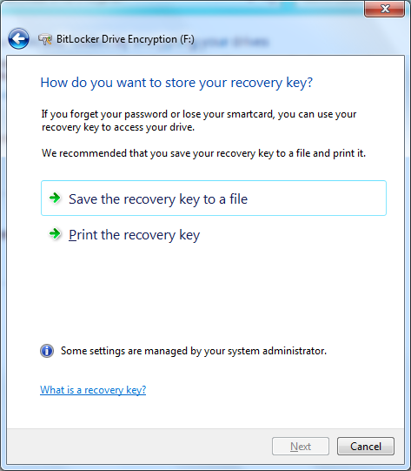
BitLocker – Recovery Key
All Bitlocker deployments require a copy of the recovery password to be stored somewhere
Out of the box, your users must save their own recovery password
This probably isn’t the best idea…

Slide 17
BitLocker - Issues
High security environments can require a pin # or USB key before the system will boot
Remote systems or servers in datacenter - BEWARE
BitLocker is not a replacement for EFS
BitLocker protects the whole drive at boot
No protection from user A seeing user B’s files post boot
EFS solves this problem

Slide 18
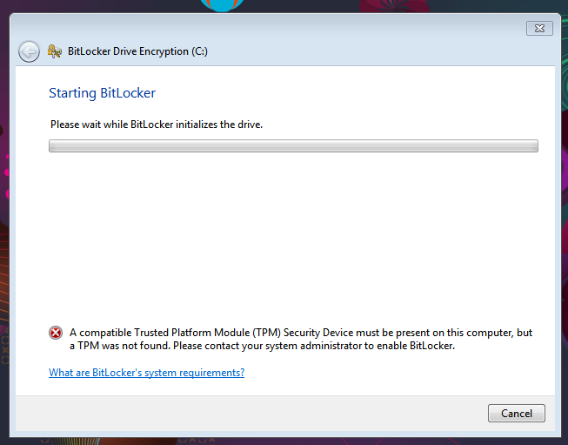
BitLocker - Issues
Trusted Platform Module required

Slide 19
BitLocker – Corporate Environment
Requires Windows Server 2003 SP1 or newer domain controllers
Group Policy – Require Encryption!
Universal Recovery Key: Data Recovery Agent
What about deleted/disabled computer accounts?
Sales guy who’s always on the road
High-powered exec who goes on a 3-month sabbatical

Slide 20
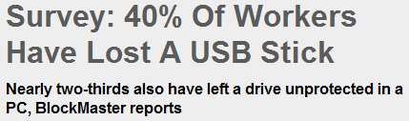
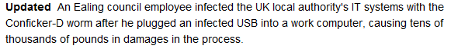
Agenda
BitLocker To Go
Encrypt Removable Media
Lost USB drive with corporate information?
Introduction to Windows 7
Internet Explorer 8
BitLocker and BitLocker to Go
AppLocker
http://bit.ly/iJv4v
http://bit.ly/1zFl3

Slide 21
Agenda
BitLocker To Go - Issues
Does not work with other OS
FAIL
On Vista and XP you can view content but not edit
FAIL
Password based
Recovery file?
Brute force?
Introduction to Windows 7
Internet Explorer 8
BitLocker and BitLocker to Go
AppLocker

Slide 22
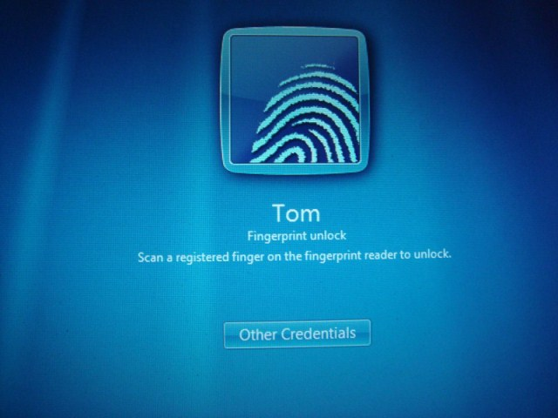
Biometric Security
Options with most new laptops
Had to use OEM software
HP Biometric Security – FAIL
Can login Local or Domain

Slide 23
Agenda
Internet Explorer 8
Introduction to Windows 7
Internet Explorer 8
BitLocker and BitLocker to Go
AppLocker
Can be used on XP and Vista
Better than IE 6 and 7
SmartScreen
XSS Filter
Data Execution Prevention
Notes:
DEP Prevents malicious code from writing to memory

Slide 24
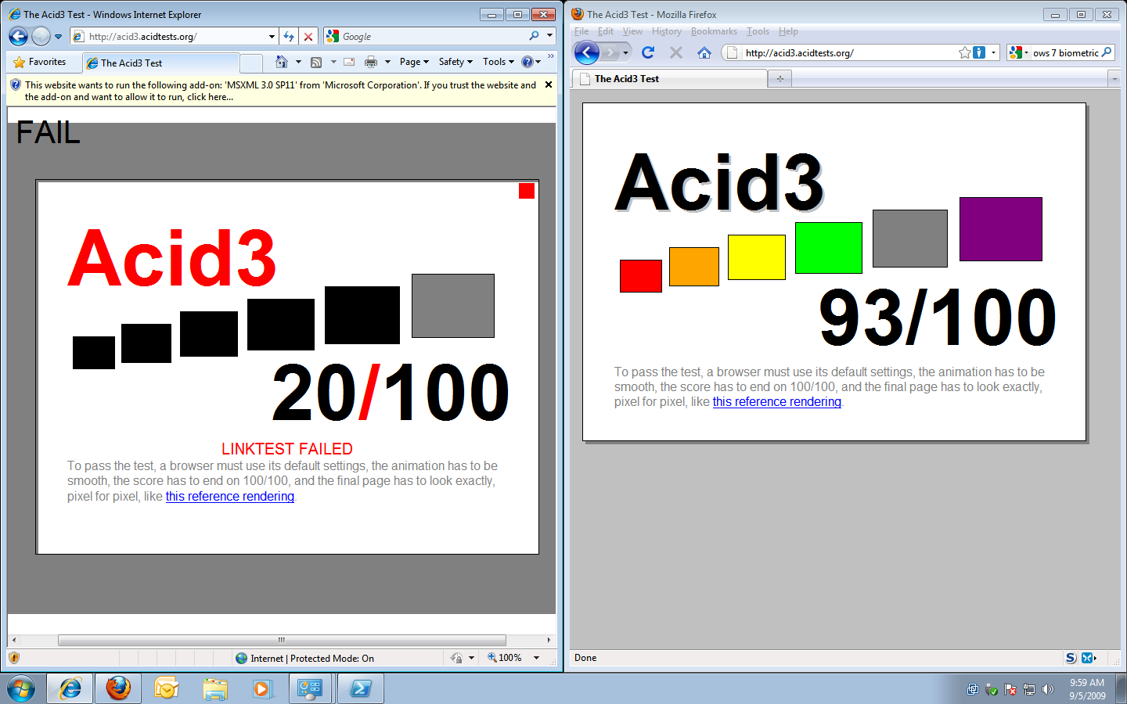
Agenda
Internet Explorer 8 – Acid Test?
Introduction to Windows 7
Internet Explorer 8
BitLocker and BitLocker to Go
AppLocker

Slide 25
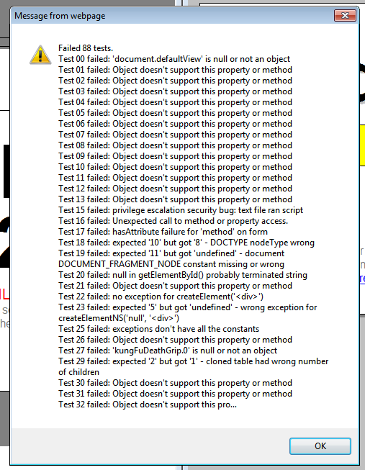
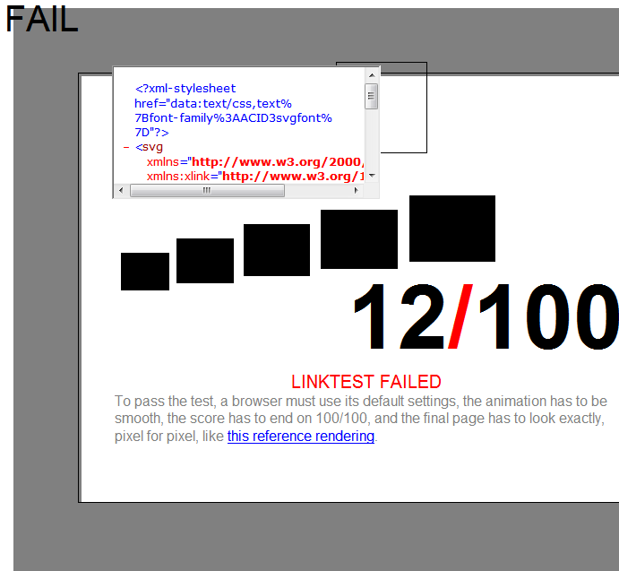
Agenda
Internet Explorer 8 – Acid Test?
Introduction to Windows 7
Internet Explorer 8
BitLocker and BitLocker to Go
AppLocker

Slide 26
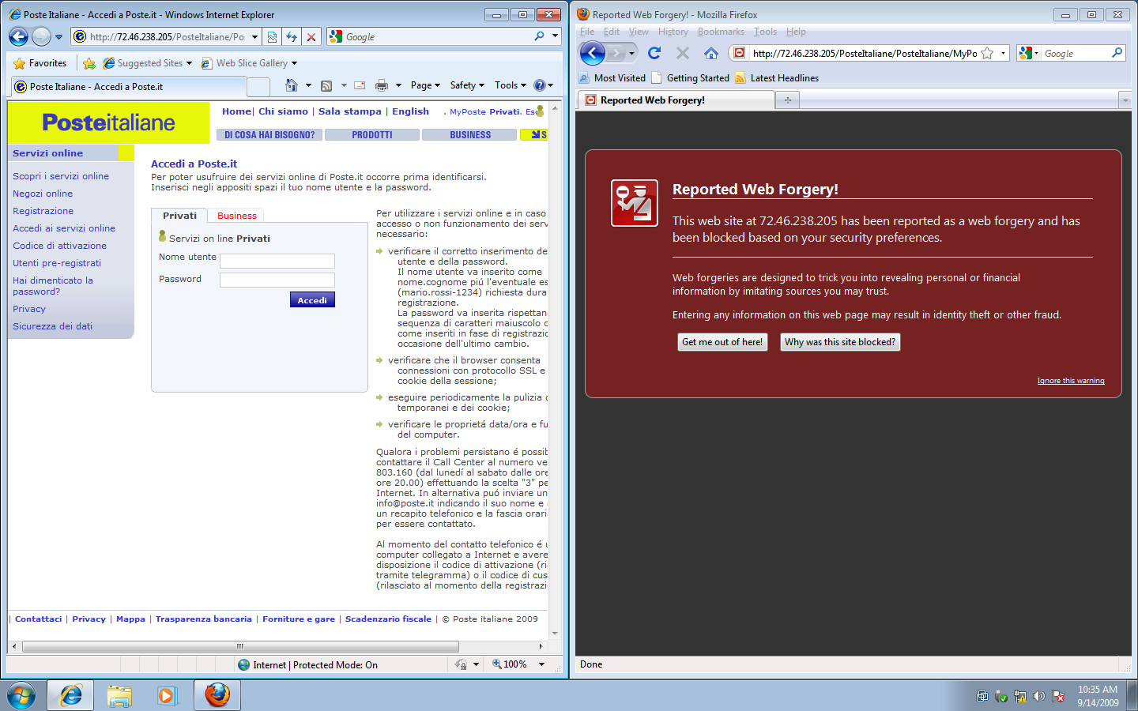
Agenda
Internet Explorer 8 – SmartScreen?
Introduction to Windows 7
Internet Explorer 8
BitLocker and BitLocker to Go
AppLocker

Slide 27
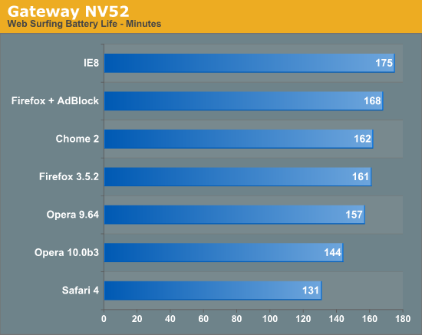
Agenda
Internet Explorer 8 – FTW?
Introduction to Windows 7
Internet Explorer 8
BitLocker and BitLocker to Go
AppLocker
http://bit.ly/17KT8I

Slide 28
Agenda
XP Mode
Introduction to Windows 7
Internet Explorer 8
BitLocker and BitLocker to Go
AppLocker
XP remains App standard
Makes it easy to be compatible
Don’t forget to secure this VM!

Slide 29
With Server 2008 R2
Windows 7 with Microsoft Windows Server 2008 R2 features:
AppLocker
Application White Listing
Enforce App Standardization
Branchcache
Caches files from WAN
DirectAccess
No need for VPN
Easier for administration
Uses SSL, IPv6, IPSec
Federated Search
Search all assets including SharePoint

Slide 30
Management
PowerShell v2
IIS
Exchange
Cmdlets
Remote Management
Enhanced Group Policy

Slide 31
Secure?
So far yes!
September Patch Tuesday
None for Windows 7
SMB2 0day?
Does not affect Windows 7 final
http://bit.ly/10ffcx

Slide 32
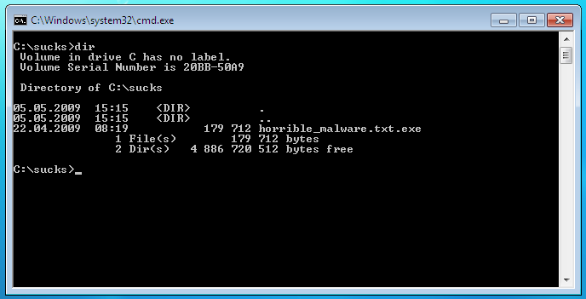
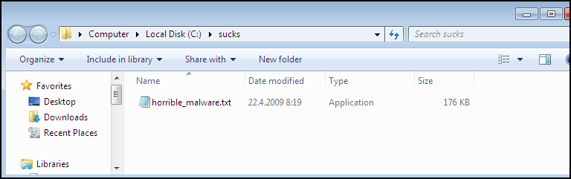
Hide extensions for known file types

Slide 33
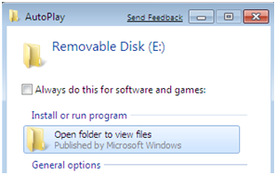
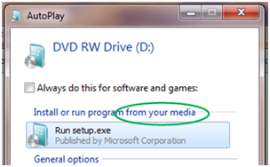
AutoRun
No longer AutoRun/ AutoPlay with non-optical media
Easier to distribute CD’s than Flash Drives!
Patch available for past OS
http://support.microsoft.com/kb/971029

Slide 34
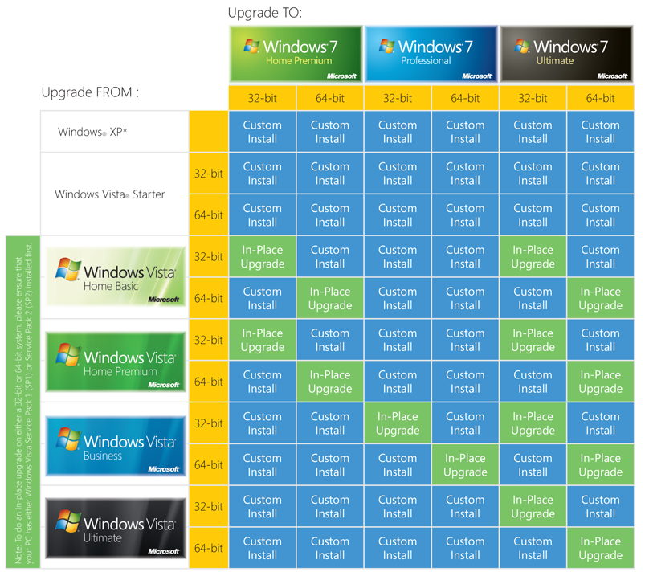
Easy upgrade path?

Slide 35
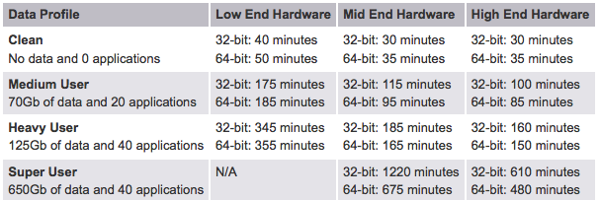
Upgrade can take a full day!
http://bit.ly/39iiVt

Slide 36
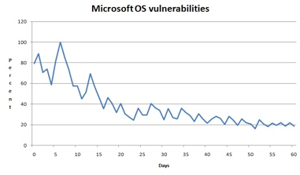
Agenda
Evolve
Introduction to Windows 7
Internet Explorer 8
BitLocker and BitLocker to Go
AppLocker
Cyber Crime is UP!
Threats have evolved
Less platform-centric
http://bit.ly/akwRT
http://www.sans.org/top-cyber-security-risks/

Slide 37
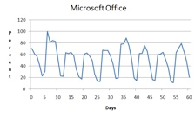
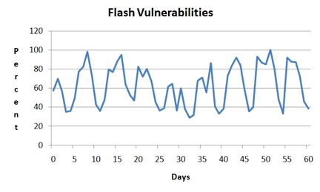
Agenda
Evolve
Attack the applications
Attack the browsers
Attack the users
Introduction to Windows 7
Internet Explorer 8
BitLocker and BitLocker to Go
AppLocker

Slide 38
Agenda
Evolve – Stay Current
Introduction to Windows 7
Internet Explorer 8
BitLocker and BitLocker to Go
AppLocker
Train Users!
Security Awareness
Browser Security
Windows Training?

Slide 39
Recap
If you run Windows now, you will be on 7 eventually
Secure it!
Educate Users
Use BitLocker or FDE
Patch Everything
Use AntiMalware
Use Firefox
no script - http://noscript.net/
WOT - http://www.mywot.com/

Slide 40
Recap
Carefully plan migration from XP to 7
Train users:
Security Awareness
Browser Use
Windows 7 training

Slide 41
Questions?
Thank You
Email: jorgeao@gmail.com
Blog: http://www.orchilles.com
http://www.twitter.com/jorgeorchilles

